Slide 1

Course Project Two: Design a Secure Network with Packet Tracer
Class: CS 4220, T-TH
By: Rafael Rojero,
Abe Anderson,
Mingma Sherpa

Slide 2
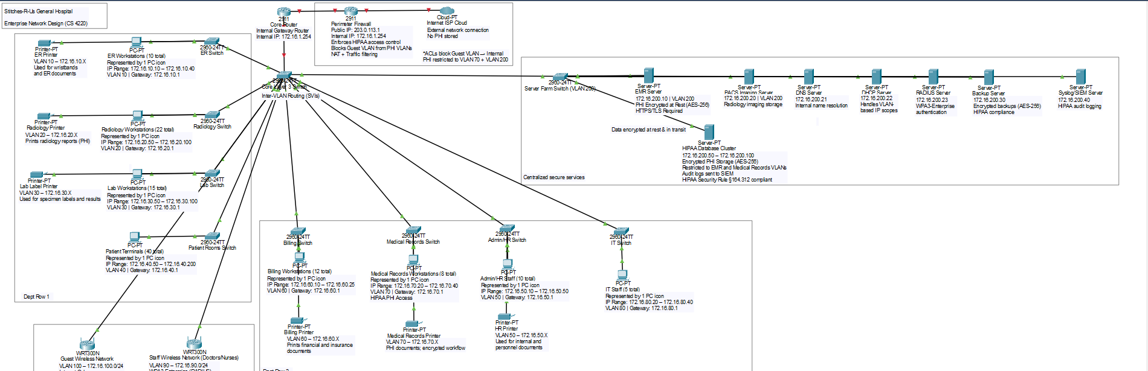
Introduction:
For Course Project Two, we designed is a secure hospital network in Packet Tracer. The design includes the full hospital layout, VLANs, subnetting, wireless, the server farm, and all the security and HIPAA protections the project asked for.

Slide 3

Project Requirements:
The project required me to build a secure hospital network in Packet Tracer that included:
A full physical layout of all hospital departments
Logical design with VLANs and subnetting
Secure wireless for staff and guest access
A complete server farm with backups and authentication
HIPAA protections for patient data
Firewalls, routing, and overall network security
I used these requirements as my checklist while building the design.

Slide 4
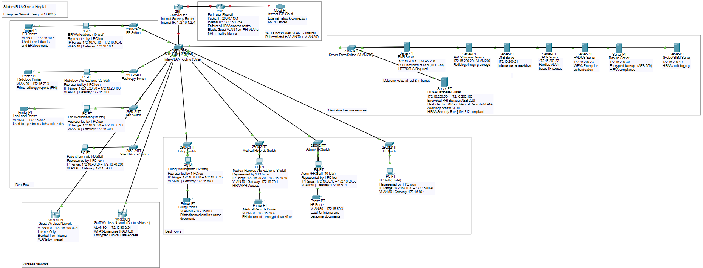
Physical & Logical Network Design:
One integrated diagram showing both physical layout and logical configuration
Departments grouped physically (ER, Radiology, Lab, Patient Rooms, Billing, Medical Records, Admin/HR, IT)
Core network at the top: ISP → Firewall → Router → Core Switch
VLAN segmentation, subnetting, gateways, and security controls shown as annotations
Server Farm physically isolated with EMR, PACS, DNS, DHCP, RADIUS, Backup, and HIPAA Database Cluster
Wireless networks separated for guest and staff
HIPAA-required encryption and ACLs marked directly on the map

Slide 5
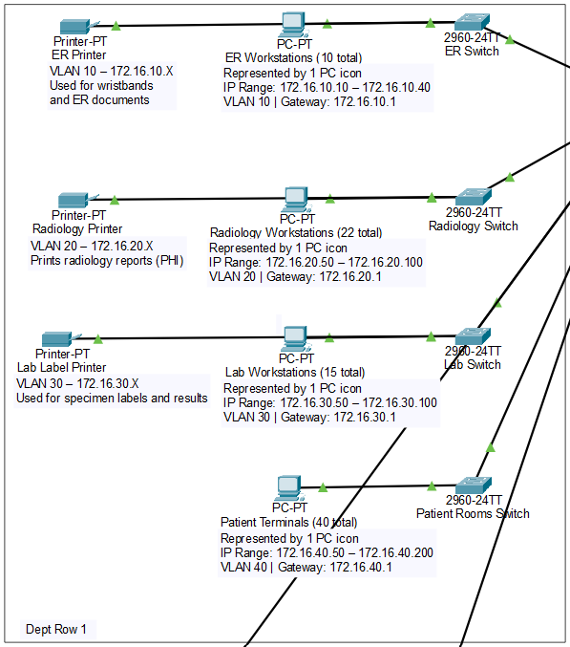
IP Addressing & Subnetting:
Base range: 172.16.0.0 /12, assigned to hospital.
Subnets created per department, each department = its own VLAN.
Gateways assigned on .1 for consistency.
Ranges sized for number of users in each area.
PHI networks separated from general networks.
Wireless split into Guest & Staff.
VLANsServer Farm placed on dedicated secured subnets.
Public IP: 203.0.113.1, for ISP/firewall NAT.

Slide 6
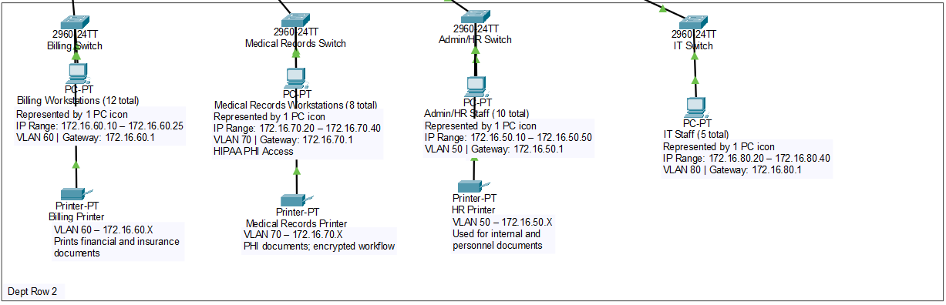
Department Subnets
Billing, Medical Records, Admin/HR, and IT each get isolated VLANs
IP ranges continue the same structure for consistency
PHI-heavy departments get additional isolation + encryption
Printers assigned to same VLAN as their department
Supports HIPAA by keeping data flows separated

Slide 7
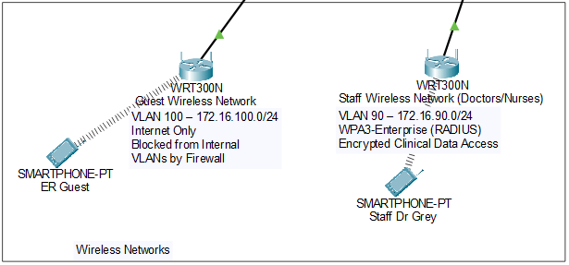
Wireless Network Design:
Two wireless networks: Staff Wi-Fi (Doctors/Nurses) and Guest Wi-Fi.
Staff Wi-Fi uses WPA3-Enterprise (RADIUS).
Guest Wi-Fi isolated on its own VLAN (Internet-only).
Firewall blocks guest access to internal VLANs.
Staff Wi-Fi allowed to access PHI systems with encryption.

Slide 8
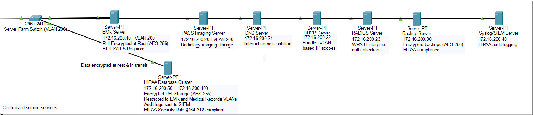
Server Farm & Secure Services:
EMR Server (PHI access, HTTPS/TLS required)
PACS Imaging Server (Radiology storage)
DNS/DHCP ServersRADIUS Server (WPA3-Enterprise)
Backup Server (Encrypted AES-256 backups)
Syslog/SIEM Server (audit logs for HIPAA)HIPAA Database Cluster (AES-256 encrypted data at rest)
All servers connected to Server Farm Switch (VLAN 200) with restricted access.

Slide 9
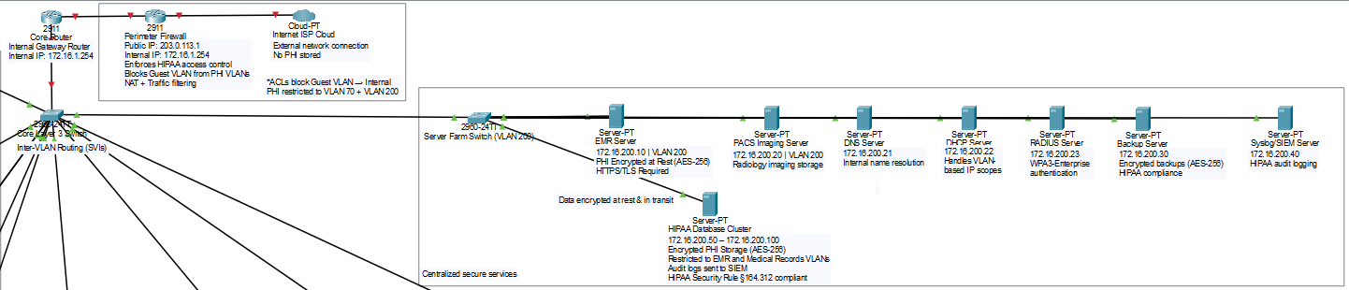
Security Architecture & HIPAA Protections:
Perimeter firewall filters traffic in/out
ACLs restrict VLANs from accessing PHI networks
VLAN segmentation for every department
IDS/IPS monitors abnormal activity
Data encrypted at rest (AES-256) & in transit (HTTPS/TLS)
Syslog/SIEM for HIPAA audit logging
RADIUS authentication for staff Wi-Fi
Guest Wi-Fi isolated from internal network

Slide 10

IP Addressing, HIPAA Compliance & Final Summary:
IP Addressing & Subnetting:
Used 172.16.0.0/12 private hospital range
Each department assigned its own subnet + VLAN
Gateways standardized on .1Server Farm isolated on VLAN 200
HIPAA Compliance:
PHI isolated in secure VLANs (Med Records, Server Farm)
AES-256 encrypted HIPAA Database ClusterTLS/HTTPS for EMR access
RADIUS + WPA3-Enterprise for Staff Wi-Fi
SIEM audit logging & monitoring
Guest Wi-Fi isolated from internal network
Summary:
Complete enterprise-level hospital network
Physical + logical design shown
Secure, segmented, scalable, HIPAA-compliant
Built fully in Packet Tracer following all project requirements

Slide 11

Thank you!

